Slide 1
Training Session
Extracting SecDFDs manually and programmatically

Slide 2
What is a secDFD?
A SecDFD is a Data-Flow Diagram extended with Security annotations
It focuses on the flow of information assets within a system

Slide 3
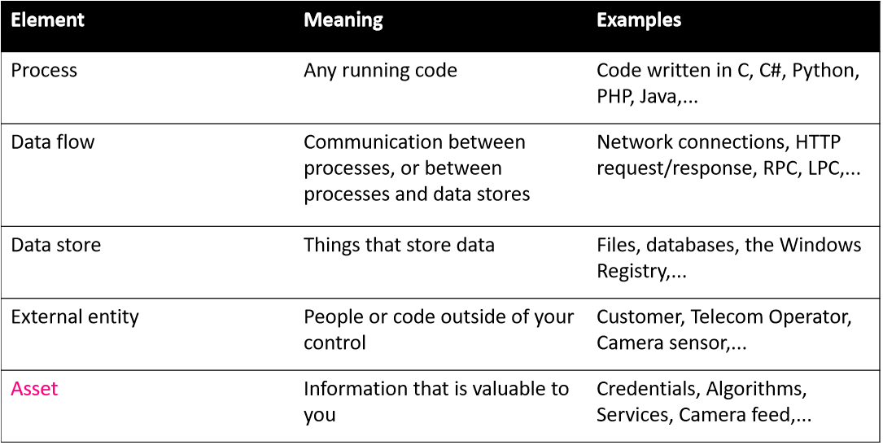

Slide 4
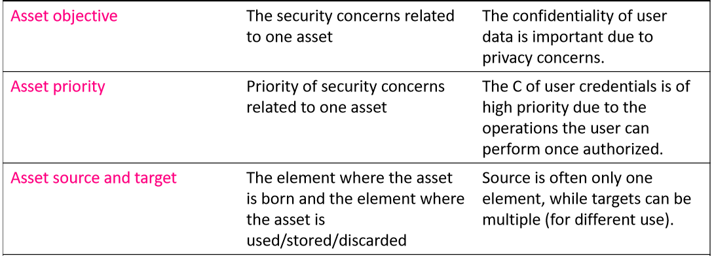

Slide 5
Manual SecDFD extraction
Steps:
identify assets
build a “regular” DFD (processes and flows)
analyze assets
extend DFD with assets, security objectives, sources, targets
define order of flows
define process responsibilities (forward, store)

Slide 6
Manual extraction: example
Android WearCamera Application

Slide 7
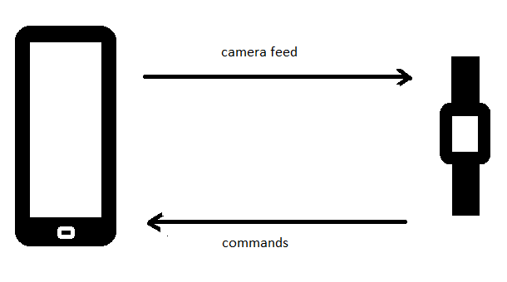
What is the android wearcamera application?
An application that allows you to remotely control the camera of an android phone from an android wearable
Transmits camera feed from phone to wearable, and allows the user to take pictures, set camera timer, and turn flash on and off on the phone camera from the wearable device
https://github.com/dheera/android-wearcamera

Slide 8
Task 1: Identify and list assets
An Asset is a piece of information that is valuable to your enterprise
Based on the description/documentation of the application, consider what the information assets may be
It is a good idea to begin by making a list of the assets
Search for their manifestation in the code

Slide 9
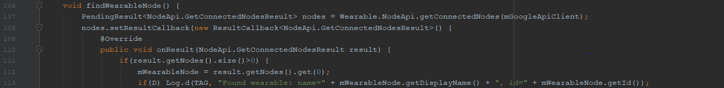
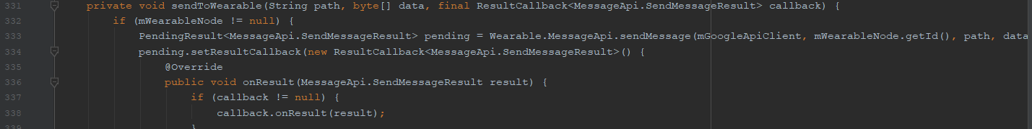
Task 1 solution
Abstract level
Code level
Camera feed
Device ID’s
”data” (parameter)
”connectedNodes” (parameter)

Slide 10
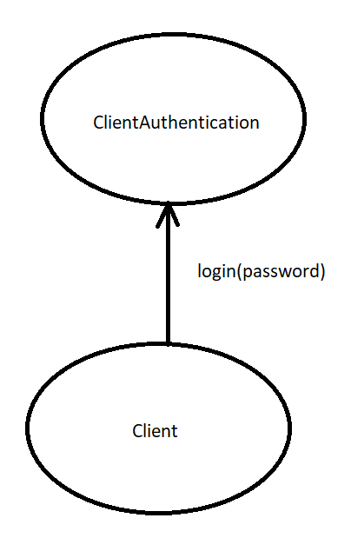
Task 2: Identify the processes and dataflows
A process is any piece of running code
A Flow is the communication between processes, i.e. the means of transporting assets

Slide 11
Task 2 solution
Processes
Flows
MobileMainAcitivity
WearableMainActivity
WearableNodeApi
WearableMessageApi
sendToWearable
mMessageListener
getConnectedNodesResult (to wearable)
getConnectedNodesResult (to mobile)

Slide 12
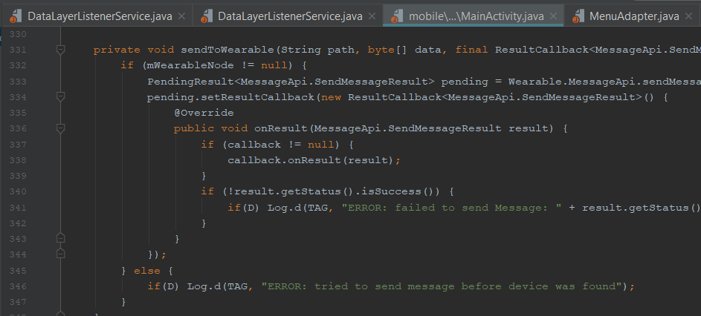
Task 2 solution cont.
Example: MobileMainActivity process
Below you see the process that transmits data from mobile to the wearable, via the API that manages device coupling
The data (which in this case is the camera feed) is then propagated to the wearable device

Slide 13
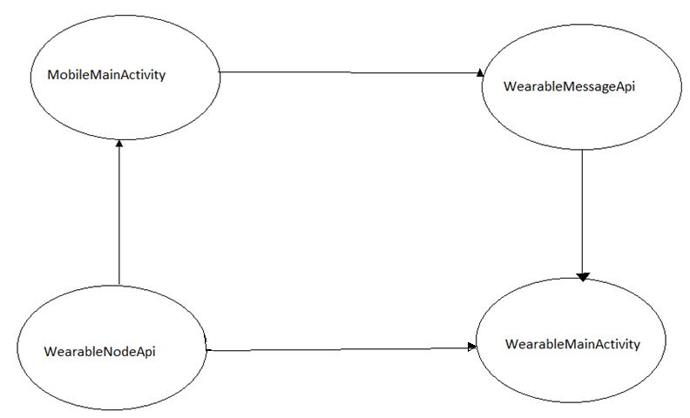
Task 2 solution cont.

Slide 14
Step 3: Analyze assets
What (process) is the source of the asset?
What (process) is the target of the asset?
Is the asset confidential?
Is it of high (H), medium (M), or low (L) confidentiality?
For example, in our rudimentary example from earlier, the password would be considered highly confidential. This is not explicit in the code, but rather understood.

Slide 15
Step 3: Analyze assets
Asset Data values: [H C] source: MobileMainAcitivty targets: WearableMainActivity,
Asset ConnectedNodes values: [L C] source: WearableNodeApi targets: WearMainActivity, MobileMainActivity

Slide 16
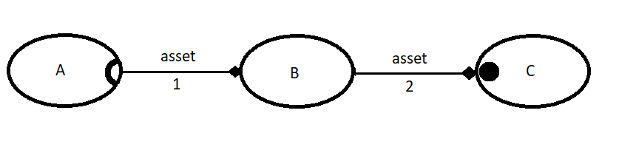
tasks 4, 5 & 6: extend DFD
extend DFD with assets’ security objectives, sources, targets
define order of flows
Give each flow a unique enumeration
define process responsibilities (forward, store)
For each asset in contact with a process, consider:
Forward: is this process propagating this asset to another process/other processes?
Store: is this processes saving, using, or otherwise storing this asset?

Slide 17
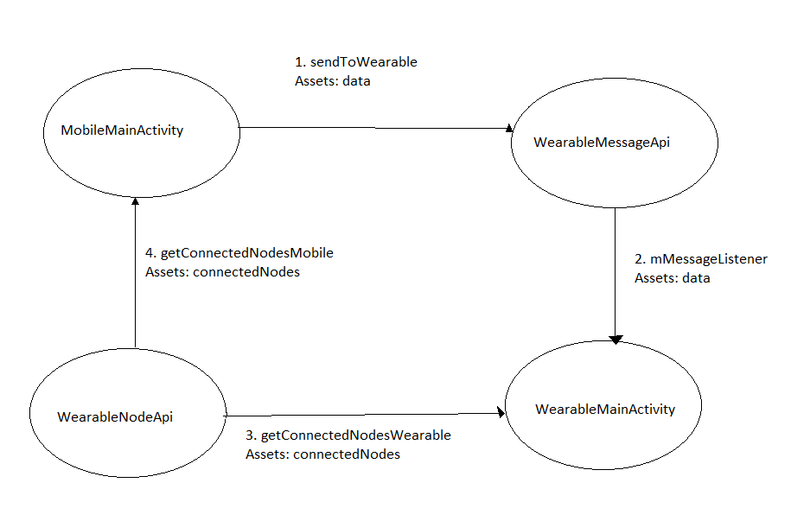
Tasks 4, 5 & 6 solution

Slide 18
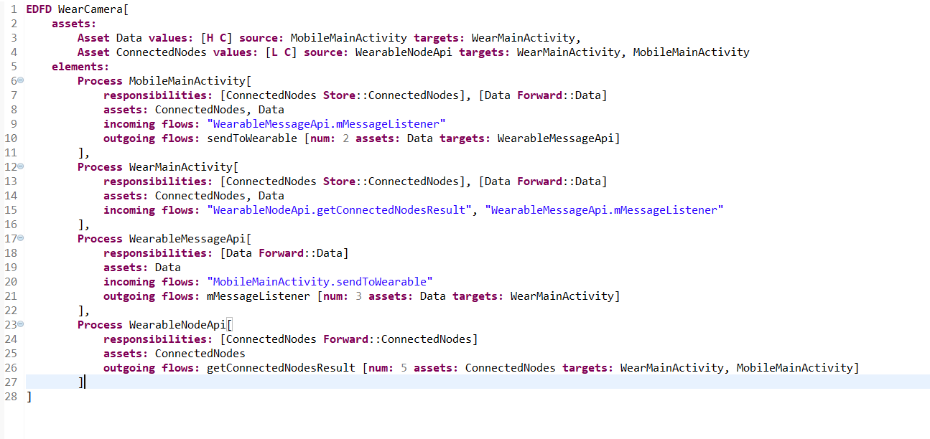

Slide 19
Using the secdfd extraction tool

Slide 20
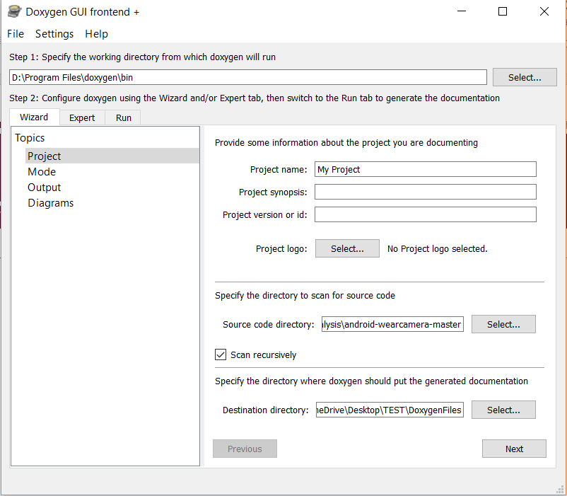
Step 1: Generate necessary files using doxygen
Select Doxygen working directory. Select the default (the Doxygen bin folder).
Specify where your source code directory is. Remember to check the “scan recursively” box.
Specify a destination directory. It is very important that you create a separate folder for this inside your dedicated folder, and remember where it is. Inside this folder, a subfolder labelled “html” will be created. The path to the html-folder (including “/html”) is the path to your .dot-files.

Slide 21
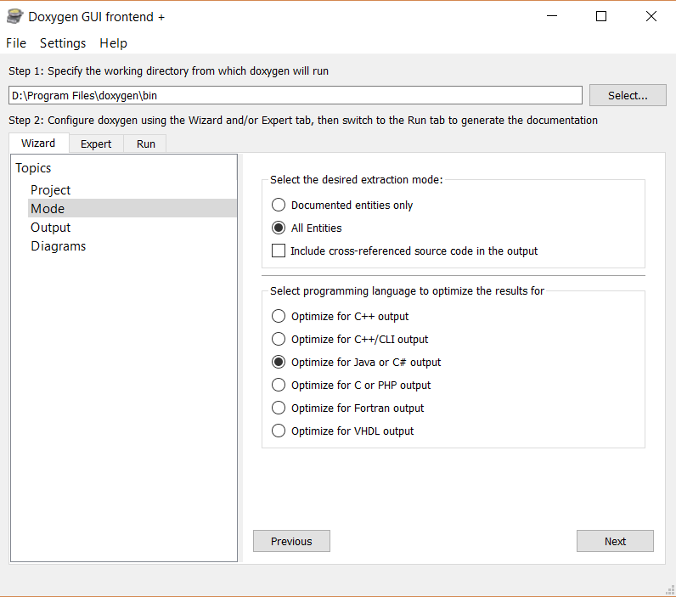
Step 1: Generate necessary files using doxygen
In the next step (”Mode”), check the buttons “All entities”, and “Optimize for Java or C# output”.

Slide 22
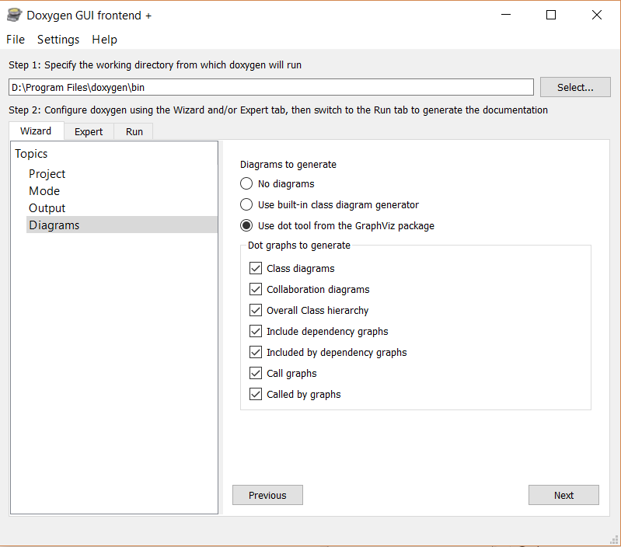
Step 1: Generate necessary files using doxygen
Under “Diagrams”, check button “Use dot tool from the GraphViz package”, and make sure boxes “Call graphs” and “Called by graphs” are checked.

Slide 23
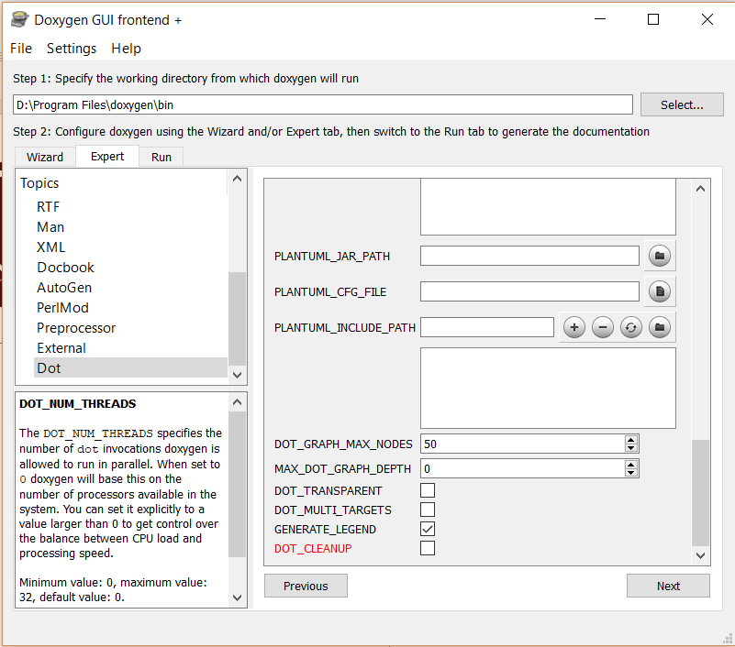
Step 1: Generate necessary files using doxygen
Select tab ”Expert”. Scroll to bottom of top left menu. Select “Dot”. In the right-side window, scroll to the bottom and uncheck variable “DOT_CLEANUP”.

Slide 24
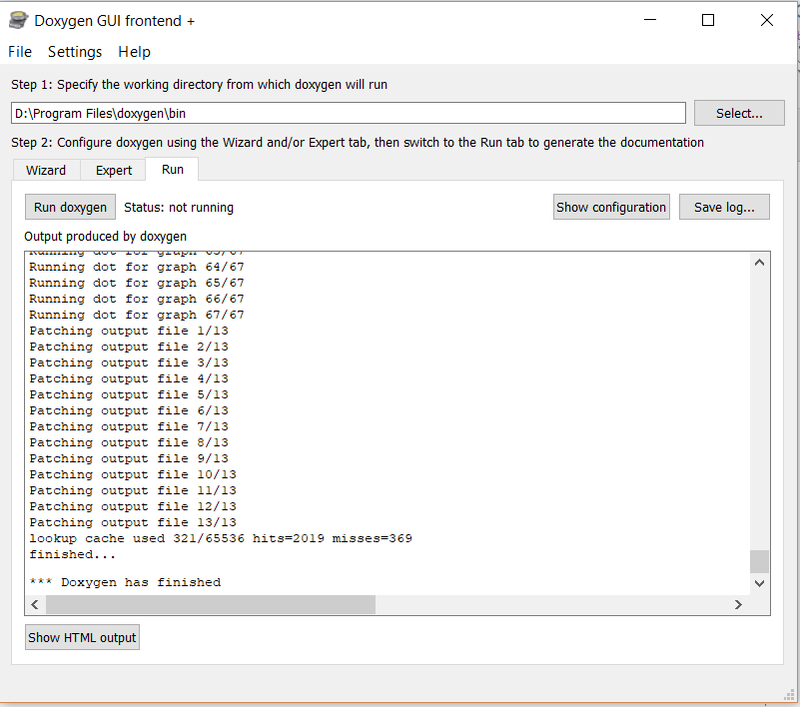
Step 1: Generate necessary files using doxygen
Finally, run Doxygen by entering the “Run” tab and clicking on the button “Run Doxygen”.

Slide 25
Step 2: Run SecDFD extraction tool (python program)
Open in the PyCharm IDE by right-clicking on the folder containing the SecDFD extraction tool (python program) and selecting “Open Folder as PyCharm Community Edition Project”
Note the file ”keywords.txt”. You may manually change the keywords used for matching confidential assets by editing this file.
Run “Main.py”. You may do this by right-clicking on the file and selecting option “Run”. Follow the command line promps.
OBS! Make sure to save the .mydsl-file where you will find it.

Slide 26
secdfd extraction tool Example
Android wearcamera application

Slide 27
DEMO

